Slide 1
ABSTRACT:
As we know that day by day enhancement rate of technology as per requirement are on the top priority. If we see today’s atmospheric condition due to air pollution then air pollution detection monitoring system becomes preferably required. It may play useful role regarding this issue. It is directly related to human life. Air pollution causes many types of diseases and disorders such as cancer, lupus, allergic reactions, asthma, nasal infection, eye problems etc. It also creates imbalance in atmosphere. To combat this problem of air pollution, we have proposed a system that will detect air pollution and display the status by using LCDs and buzzer. This System is designed using Arduino uno. This system provides effective solution to save our environment by controlling air pollution.
KEY WORDS: Air pollution, Arduino

Slide 2
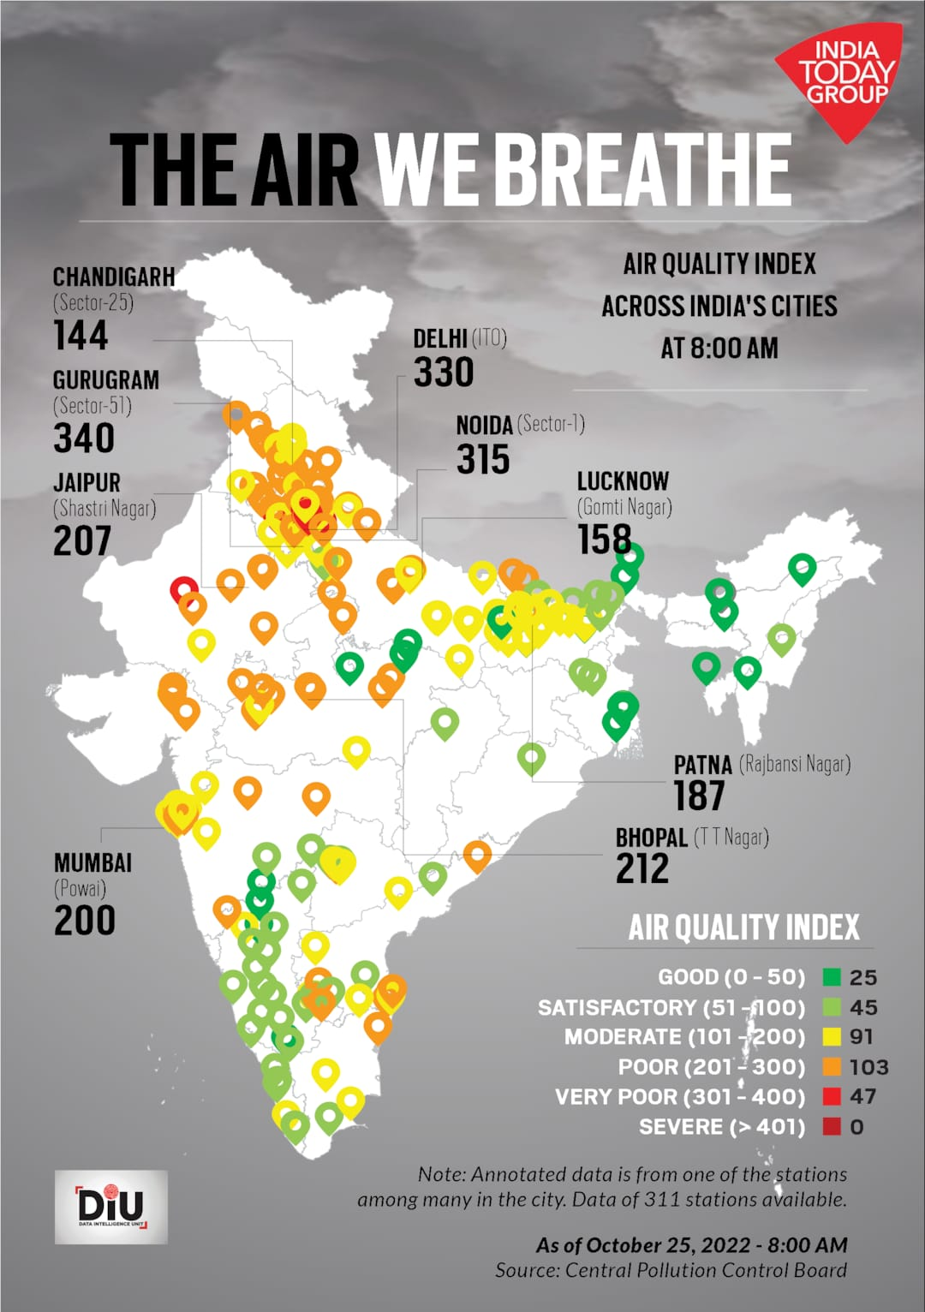
INTRODUCTION:
Air pollution is the biggest problem of every nation, whether it is developed or developing. Health problems have been growing at faster rate especially in urban areas of developing countries where industrialization and growing number of vehicles leads to release of lot of gaseous pollutants. Harmful effects of pollution include mild allergic reactions such as irritation of the throat, eyes and nose as well as some serious problems like bronchitis, heart diseases, pneumonia, lung and aggravated asthma. According to the world bank’s report on air pollution, air pollution causes an estimated 2 million premature deaths across the region each year in India. Whereas in EU number reaches to 300,000 and over 3,000,000 worldwide. To overcome this problem we designed an Air Pollution Detection Monitoring System monitors the air quality and will trigger an alarm when the air quality goes down beyond a certain threshold level, means when there are sufficient amount of harmful gases present in the air like CO2, smoke, alcohol, benzene, NH3 and NOx. It will show the air quality in PPM on the LCD so that it can monitor it very easily. The system can be installed anywhere where gases are mostly to be found and buzzer starts beeping when the system crosses the threshold limit.

Slide 3
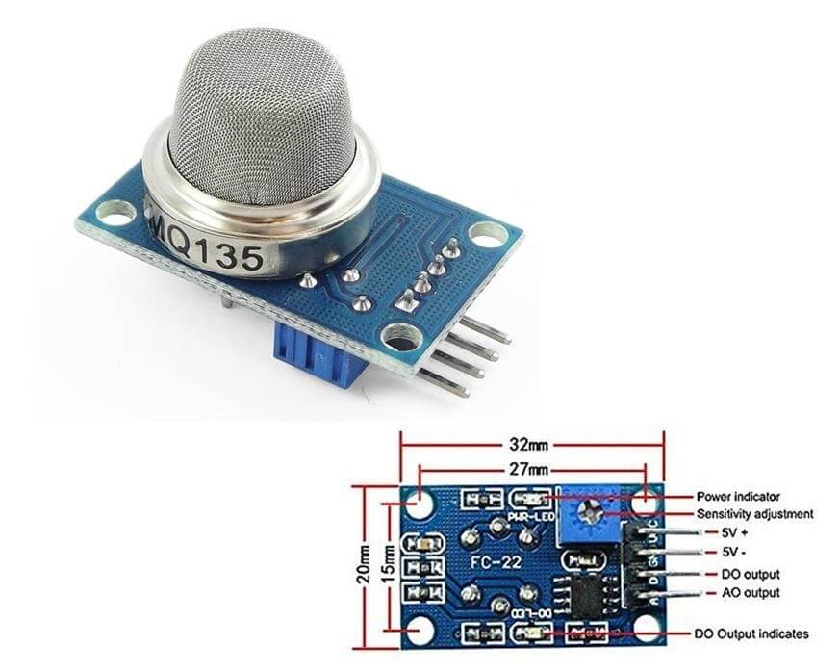
METHODOLOGY:
REQUIREMENTS:
HARDWARE COMPONENTS:
MQ135 Gas sensor
Arduino Uno
16X2 LCD
Breadboard
10K potentiometer
Buzzer
SOFTWARE USED:
Arduino IDE
1. MQ135 GAS SENSOR:
The MQ135 sensor can sense NH3, NOx, alcohol, Benzene, smoke, CO2 and some other gases. It gives the output in form of voltage levels. It is used as Gas leakage detector,Industrial combustile gas detectors.
2.ARDUINO UNO:
Arduino Uno is a microcontroller board based on the ATmega328P It has 14 digital input/output pins 6 analog inputs, a 16 MHz quartz crystal, a USB Connection, power jack, an ICSP header and a reset button.

Slide 4
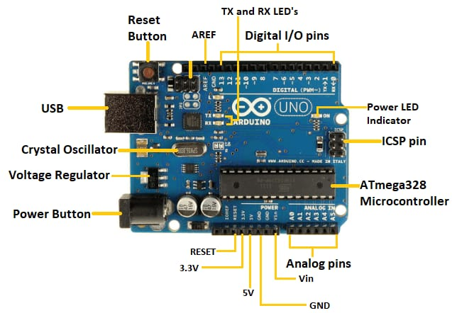
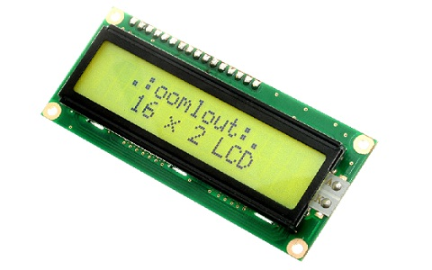
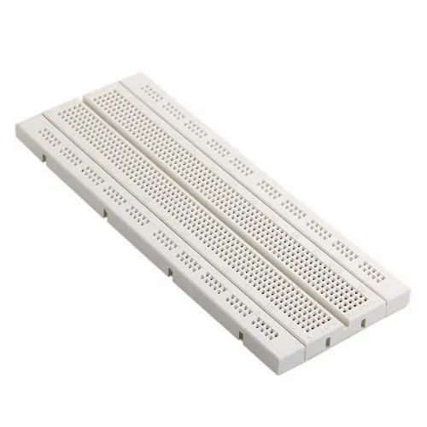
4.16X2 LCD:
This is a basic (16x2) 16 character by 2 line display. Black text on Green background. It is used to indicate the Air in PPM
5.BREAD BOARD:
A breadboard is used to make up temporary circuits for testing or to try out an idea. No soldering is required so it is easy to change connections and replace components.

Slide 5
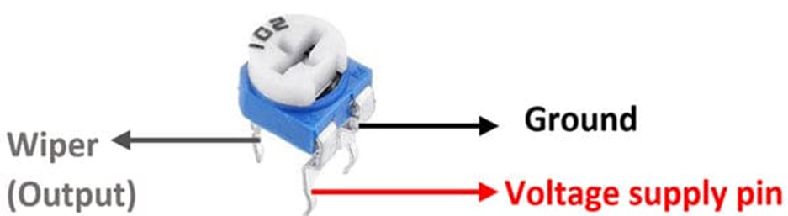
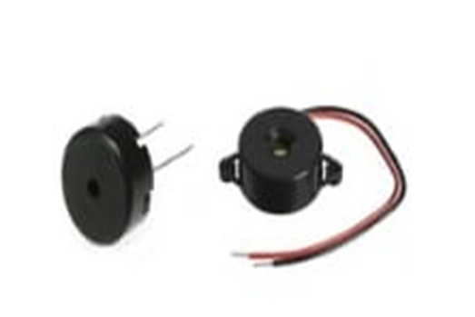

6.10K POTENTIOMETER:
Potentiometers are very useful in changing the electrical parameters of a system. It is a single turn 10k Potentiometer with a rotating knob. These potentiometers are also commonly called as a rotary potentiometer or just POT in short. These three-terminal devices can be used to vary the resistance between 0 to 10k ohms by simply rotating the knob.
7.BUZZER:
A Buzzer or beeper is an audio signaling device. Whenever the air pollution goes above the threshold level the Buzzer starts beeping indicating Danger.
8.ARDUINO IDE:
Here in this project we are using Arduino IDE.It is a open source IDE developed by Arduino .It supports c++ embedded language. It is supported by all operating systems(like Windows,mac OS,lLnux).

Slide 6
CIRCUIT DIAGRAM AND EXPLANATION:
Firstly we will connect the MQ135 sensor with the Arduino. Connect the VCC and the ground pin of the sensor to the 5V and ground of the Arduino and the Analog pin of sensor to the A0 of the Arduino.
Connect a buzzer to the pin 8 of the Arduino which will start to beep when the condition becomes true.
In last, we will connect the LCD to arduino . The connections of the LCD are as follows
Connect pin 1 (VEE) to the ground.
Connect pin 2 (VDD or VCC) to the 5V.
Connect pin 3 (V0) to the middle pin of the 10K potentiometer and connect the other two ends of the potentiometer to the VCC and the GND. The potentiometer is used to control the screen contrast of the LCD. Potentiometer of values other than 10K will work too.
Connect pin 4 (RS) to the pin 12 of the arduino
Connect pin 5 (Read/Write) to the ground of Arduino. This pin is not often used so we will connect it to the ground.
Connect pin 6 (E) to the pin 11 of the Arduino. The RS and E pin are the control pins which are used to send data and characters.
The following four pins are data pins which are used to communicate with the Arduino.
1 Connect pin 11 (D4) to pin 5 of Arduino.
2 Connect pin 12 (D5) to pin 4 of Arduino.
3 Connect pin 13 (D6) to pin 3 of Arduino.
4 Connect pin 14 (D7) to pin 2 of Arduino.
Connect pin 15 to the VCC
Connect pin 16 to the Ground.

Slide 7
WORKING EXPLANATION:
FIG: BLOCK DIAGRAM
The MQ135 sensor can sense NH3, NOx, alcohol, Benzene, smoke, CO2 and some other gases, so it is perfect gas sensor for our Air Pollution Detector Project. When we will connect it to Arduino then it will sense the gases, and we will get the Pollution level in PPM (parts per million). MQ135 gas sensor gives the output in form of voltage levels and we need to convert it into PPM. So for converting the output in PPM, here we have used a library for MQ135 sensor.
Sensor was giving us value of 90 when there was no gas near it and the safe level of air quality is 350 PPM and it should not exceed 1000 PPM. When it exceeds the limit of 1000 PPM, then it starts cause Headaches, sleepiness and stagnant, stale, stuffy air and if exceeds beyond 2000 PPM then it can cause increased heart rate and many other disease
When the value will be less than 1000 PPM, then the LCD will display “Fresh Air”. Whenever the value will increase 1000 PPM, then the buzzer will start beeping and the LCD will display “Poor Air, Open Windows”. If it will increase 2000 then the buzzer will keep beeping and the LCD will display “Danger! Move to fresh Air”.
ARDUINO UNO
MICRO CONTROLLER
10K POTENTIOMETER
POWER SUPPLY
16*2 LCD DISPLAY
MQ135 GAS SENSOR
BUZZER

Slide 8
FIG: FLOW CHART FOR THE PROPOSED SYSTEM
Start
Get the value from MQ135 gas sensor in ppm
Value=V
True
If
V<1000ppm
Display
“Fresh air”
False
If V>1000&
V<2000 ppm
True
False
Display
“Poor Air,Open Windows”
If V>2000ppm
True
Display
“Danger! Move to Fresh Air”
stop

Slide 9
ADVANTAGES:
Easy to Install
Has realiable stability
Accurate Pollution monitoring
Making data available to users
Continuous updates of change in percentage of quality
Detects wide range gases like CO2,CO,NH3 etc
Sensors are easily available
Visual output
Indoor quality of air can be checked
It is affordable
FUTURE SCOPE:
In future the project can be upgraded in more ways
Design webpage and upload data on webpage
Interface SDCARD to store the data
Interface GPS module to monitor the pollution
Interface more number sensors to detect temperature, humidity of air
Designing of the system to give the alert message to the mobile phones of users
Automatically turning on the air purification devices based on the information provided by air pollution detector.
APPLICATIONS:
Indoor and outdoor air quality monitoring system
Gas detection systems
Smoke detection
CONCLUSION:

